Slide 1

Topic Modelling
Team Name :: G5
Team Members:
Battu priyanka
Rohit
Sukanaya
Sneha
Suresh
shilpa kate
Mentor Name:- Mr.Varun Vennelaganti
Date :- 28 June 2021

Slide 2
Business Problem:
This project consist of Social event tracking and evolution framework. We can obtain the evolutionary trends of social events and generate effective event summary details over time. The input is the textual data collected from various social media. Based on the input data, our algorithm can learn multi-modality topics and track multiple events. After tracking, for each event, it can be visualized with texts and image over time
Objective:
Implementation of Social Event Analysis Model to classify to which cluster your article belongs to.

Slide 3
Project Architecture / Project Flow
Pre-processing Text
Feature Engineering
Tokenization
Bag of Words
Text
Removing stop words
TF-IDF
Word Embedding
Stemming lemmatization
Topic Model methods :
LDA
Model Evolution
Model building

Slide 4
Dominant topic and its percentage contribution in each document
 | Document_No | Dominant_Topic | Topic_Perc_Contrib | Keywords | Text
0 | 0 | 3.0 | 0.7604 | bike, opinion, organization, line, hard, list,... | [irwin, arnstein, recommendation, summary, wor...
1 | 1 | 1.0 | 0.5824 | team, hockey, play, win, player, playoff, wing... | [gary, leung, organization, university, toront...
2 | 2 | 2.0 | 0.8223 | write, go, say, know, think, get, line, god, s... | [jonathan, hayward, pantheism, organization, w...
3 | 3 | 5.0 | 0.5537 | israel, israeli, state, kill, arab, jew, war, ... | [reply, organization, line, article, joseph_as...
4 | 4 | 2.0 | 0.6828 | write, go, say, know, think, get, line, god, s... | [goalie_mask, ists_ca, organization, ist, line...
5 | 5 | 2.0 | 0.5859 | write, go, say, know, think, get, line, god, s... | [joe, ehrlich, bmw_moa_member, read, organizat...
6 | 6 | 2.0 | 0.5262 | write, go, say, know, think, get, line, god, s... | [require, organization, line, article, tom_cor...
7 | 7 | 4.0 | 0.6542 | make, year, university, line, first, organizat... | [speedy_mercer, look, movie, bike, organizatio...
8 | 8 | 6.0 | 0.6992 | believe, christian, evidence, reason, faith, c... | [organization, florida_state, university, line...
9 | 9 | 0.0 | 0.6184 | greek, armenian, turk, people, speak, turkish,... | [serdar_argic, day, night, armenian, round, ma...

Slide 5
The most representative sentence for each topic
 | Document No | Dominant_Topic | Topic_Perc_Contrib | Keywords | Text
0 | 0 | 2.0 | 0.9426 | line, organization, write, get, article, bike, go, make, good, time | [irwin, arnstein, recommendation, summary, worth, expire, sit, gmt, organization, computrac, inc...
1 | 1 | 1.0 | 0.7488 | team, game, hockey, play, year, win, player, nhl, line, wing | [gary, leung, organization, university, toronto, system, control, group, line, article, scott, m...
2 | 2 | 0.0 | 0.8385 | god, say, people, think, christian, believe, know, reason, write, evidence | [jonathan, hayward, pantheism, organization, wheaton, college, line, article, gary, cavano, writ...
3 | 3 | 2.0 | 0.6993 | line, organization, write, get, article, bike, go, make, good, time | [goalie_mask, ists_ca, organization, ist, line, article, write, vote, go, john, vanbiesbrouck, m...
4 | 4 | 2.0 | 0.7453 | line, organization, write, get, article, bike, go, make, good, time | [joe, ehrlich, organization, holonet, national, internet, access, system, modem, line, little, b...
... | ... | ... | ... | ... | ...
95 | 95 | 0.0 | 0.8390 | god, say, people, think, christian, believe, know, reason, write, evidence | [paul_conditt, christian, aid, organization, laboratory, university, texas, austin, line, articl...
96 | 96 | 0.0 | 0.8702 | god, say, people, think, christian, believe, know, reason, write, evidence | [kershner, wyatt, quality, organization, ncr, corp, columbia, columbia, sc, line, article, steph...
97 | 97 | 2.0 | 0.7339 | line, organization, write, get, article, bike, go, make, good, time | [new, cylist, organization, division, line, article, blaise, cirelli, write, think, buy, motorcy...
98 | 98 | 2.0 | 0.9044 | line, organization, write, get, article, bike, go, make, good, time | [blaine_gardner, ducati, opinion, want, organization, line, article, albion_bower, write, previo...
99 | 99 | 1.0 | 0.9974 | team, game, hockey, play, year, win, player, nhl, line, wing | [result, game, play, sun, april, organization, university, line, ny_ranger, washington, ny_range

Slide 6
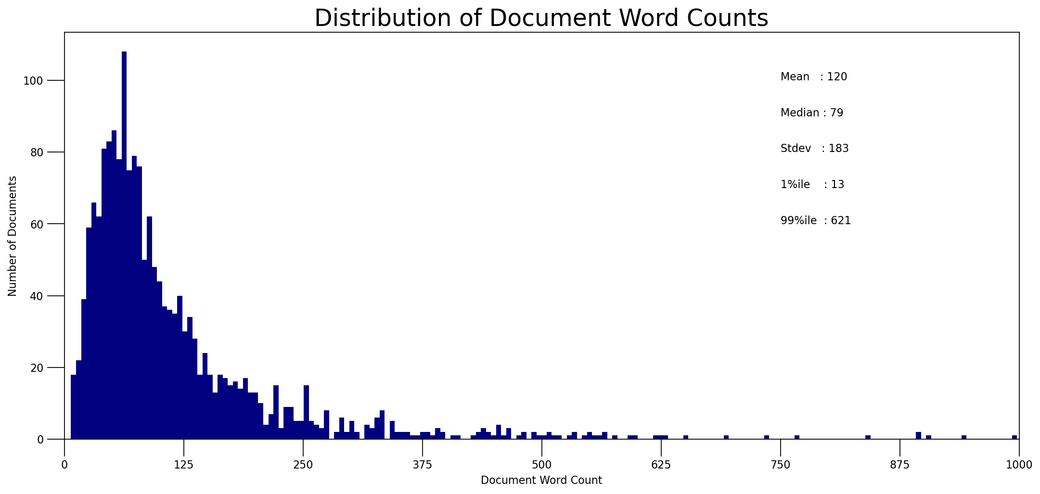
Frequency Distribution of Word Counts in Document

Slide 7
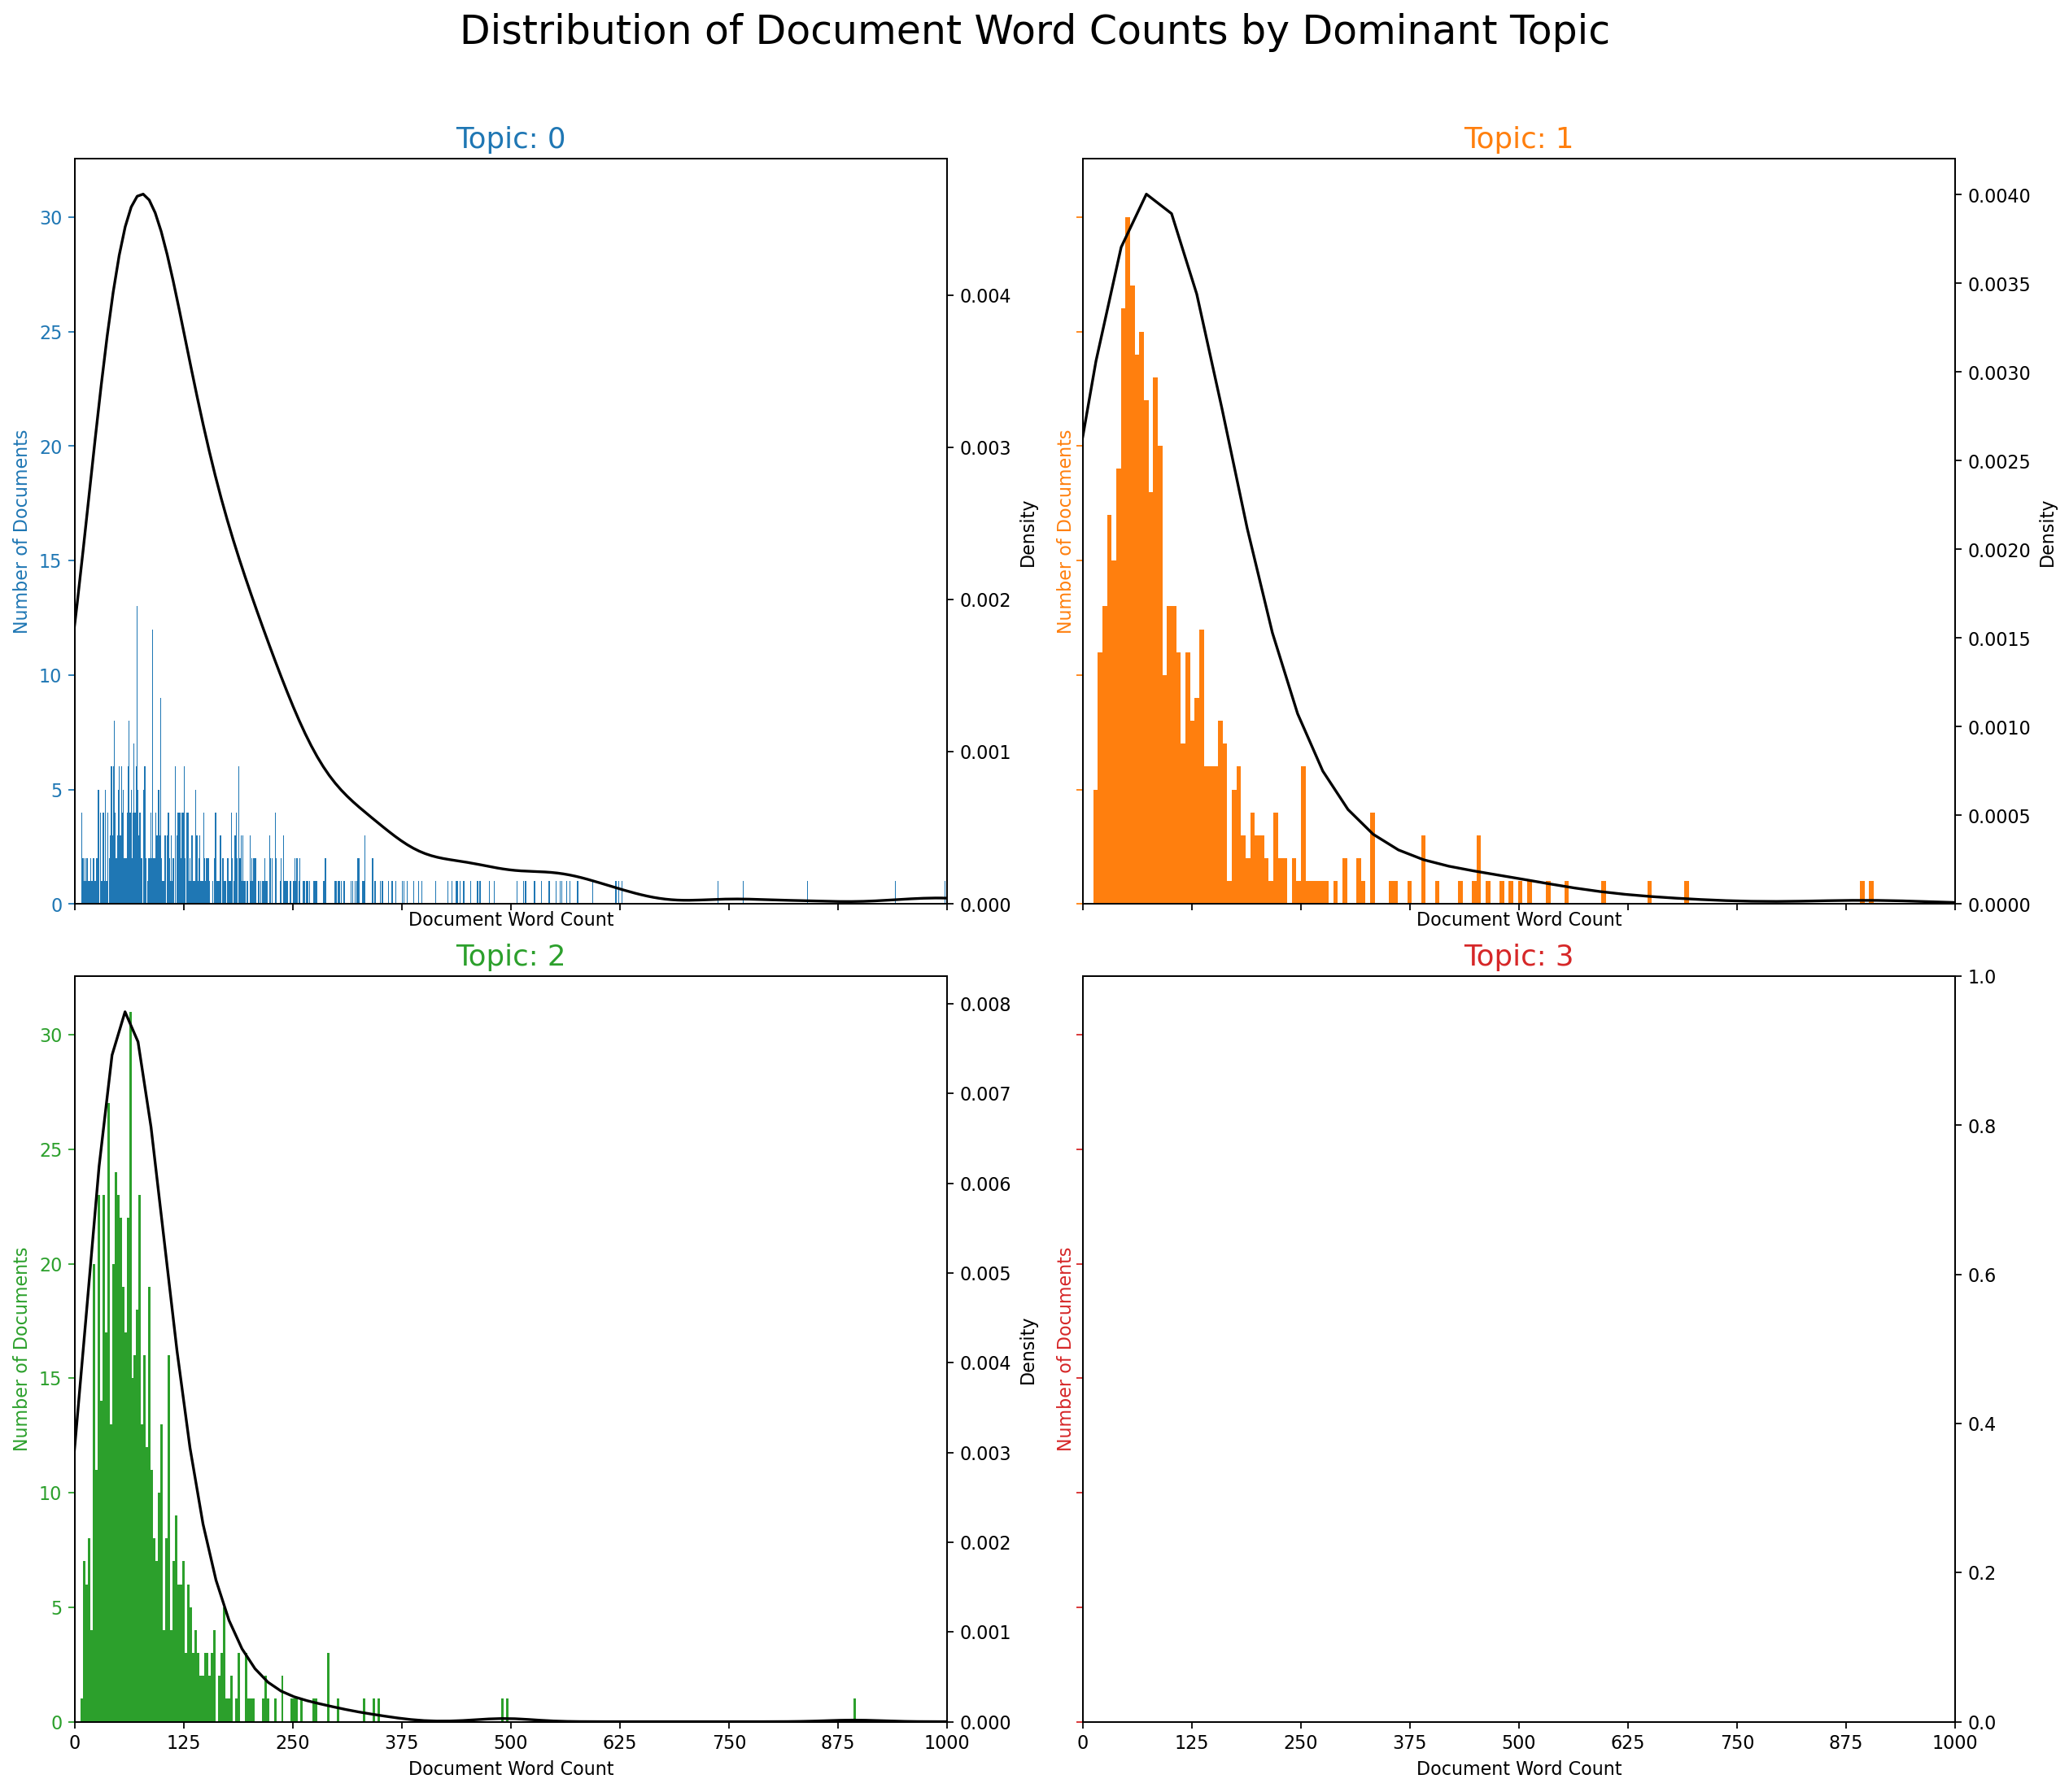
Document Word Counts by Dominant Topic

Slide 8
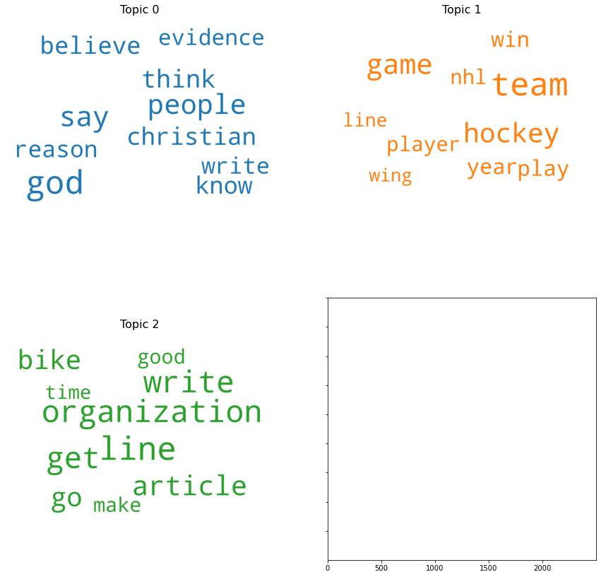
Word Clouds of Top N Keywords in Each Topic

Slide 9
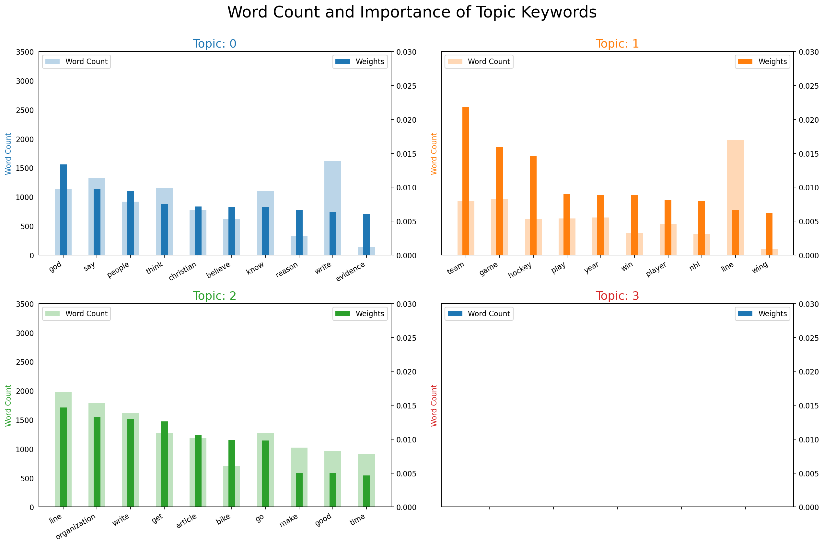
Word Counts of Topic Keywords

Slide 10
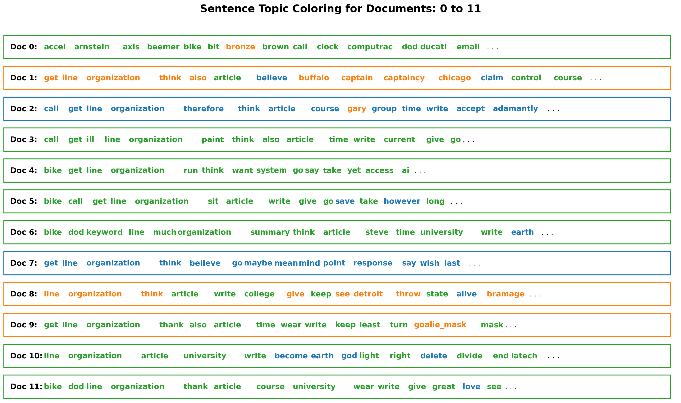
Sentence Chart Colored by Topic

Slide 11
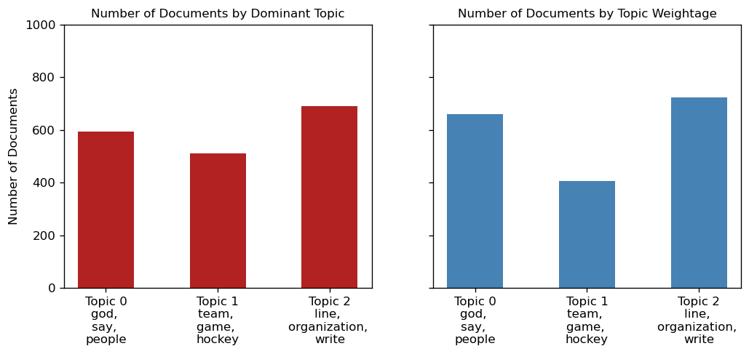
Topic most discussed topics in the documents

Slide 12
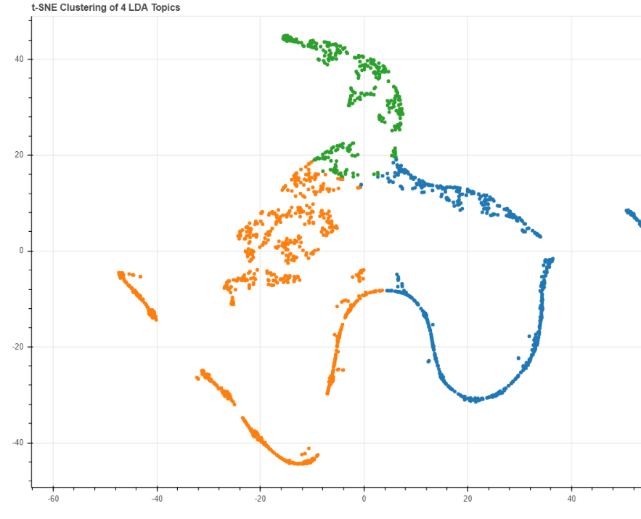
t-SNE Clustering Chart

Slide 13
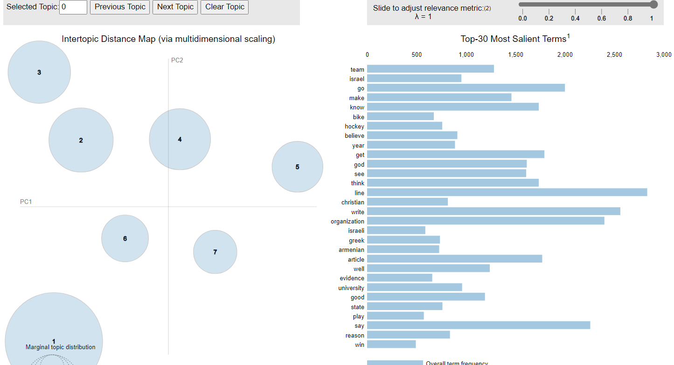
pyLDAVis

Slide 14
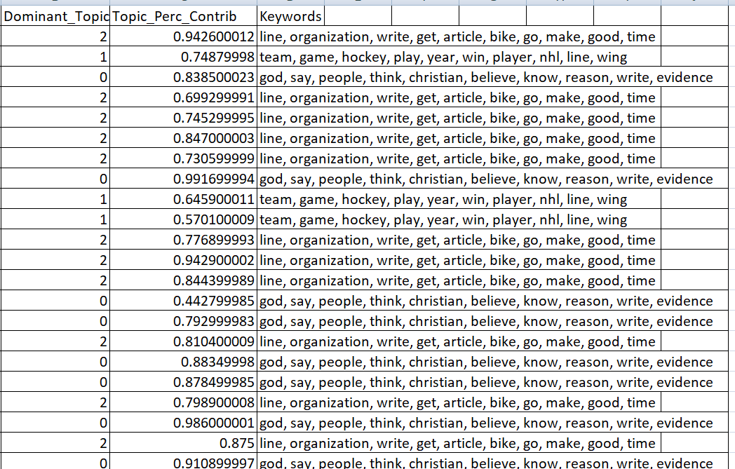
Train Dataset

Slide 15
Model Evolution
Model | accuracy score
LogisticRegressionClassifier | 1.00
RandomForestClassifier | 0.98125

Slide 16
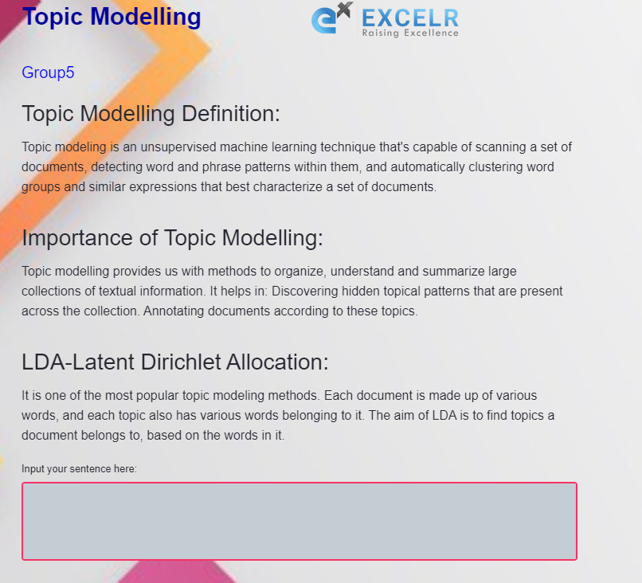
Deployment model

Slide 17
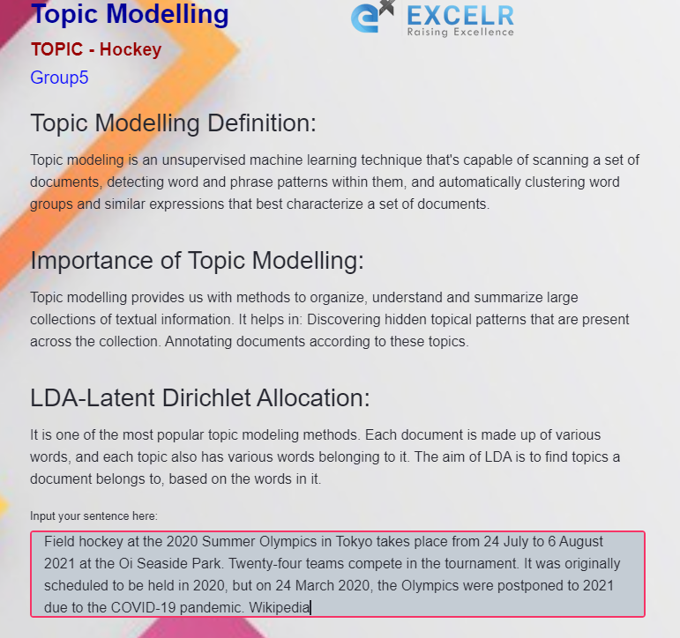
Deployment model

Slide 18
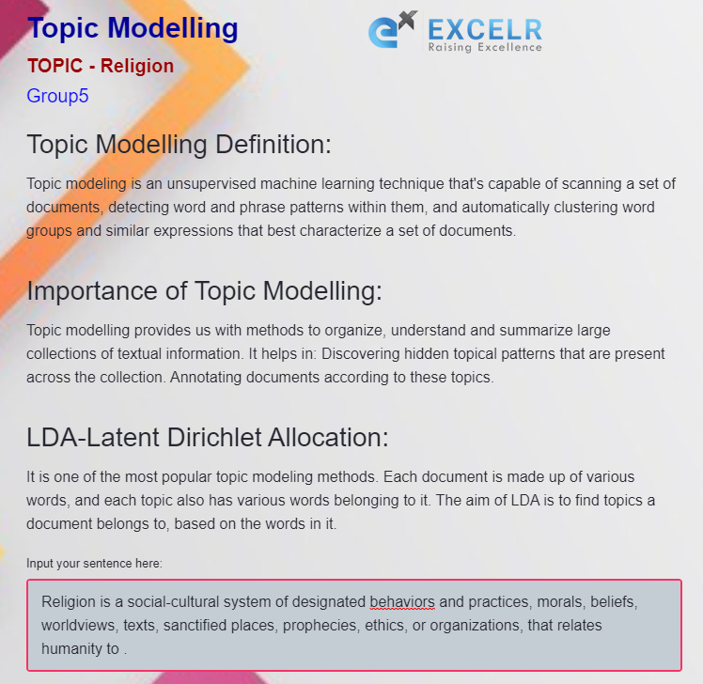
Deployment model

Slide 19
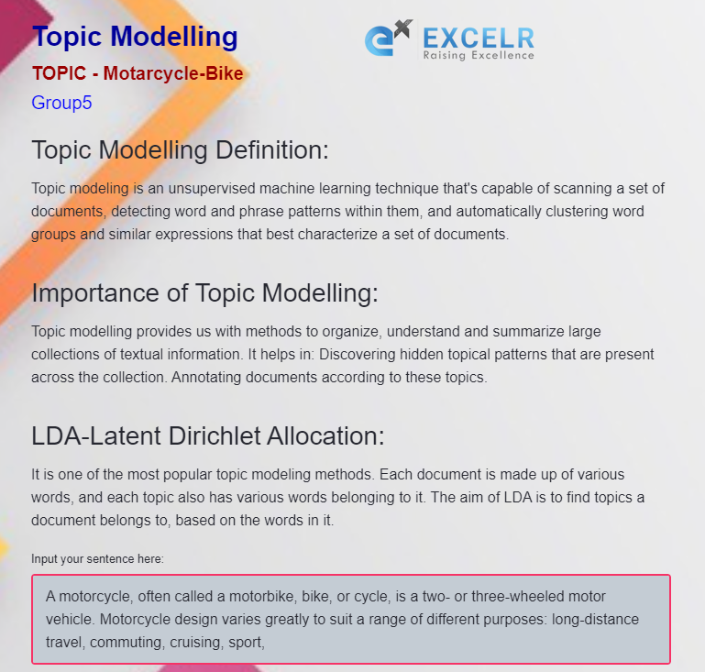
Deployment model

Slide 20
Limitations of LDA
Fixed K :- the number of topics is fixed and must be known ahead of time
Uncorrelated topics :- Dirichlet topic distribution cannot capture correlations.
Static :-no evolution of topics over time
Bag of words :- assumes words are exchangeable, sentence structure is not modelled.
Despite its limitations, LDA is central to topic modelling and has really revolutionized the field.

Slide 21
Conclusion
Topic modelling is important for text mining. You can understand how important it is to accurately judge the topic for the document and how useful it will be to get relevant and useful documents. This is one of the useful and most widely used problem statement to provide topic based on the contents of the document.
This is unsupervised learning model and LDA comes with one limitation of pre deciding the number of topics for the given document. You can make use of multiple libraries like sklearn, gensim etc to implement LDA to train the model.

Slide 22
Thank you

